Slide 1
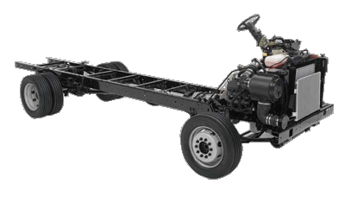
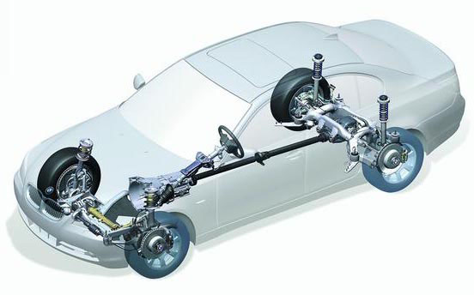
Study of 4 Wheeler Chassis Layout & Drive Layout
Experiment No 1

Slide 2
What is an Automobile?
A self propelled vehicle used for transportation of goods and passengers on ground is called automobile.
Automobile means a vehicle which can move by itself.

Slide 3
Classification of automobile
According to Use
According to Capacity
According to Fuel Used
According to Body Style
According to Number of Wheels
According to Driver sit arrangement
According to Driving Axles
According to Transmission Used

Slide 4
Chassis of vehicle
Chassis is the main supporting structure of a motor vehicle to which all other components are attached.
The chassis of an automobile consists of following components
Engine and radiator
Transmission system
Suspension system
Road wheels
Steering system
Brakes
Fuel tank

Slide 5
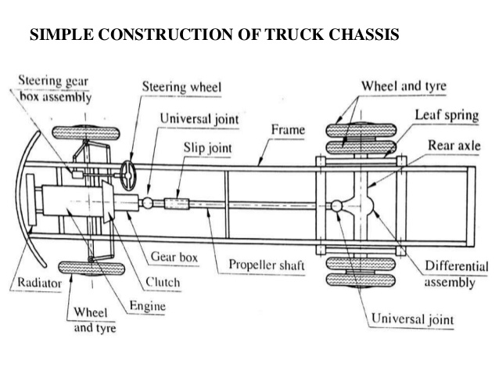

Slide 6
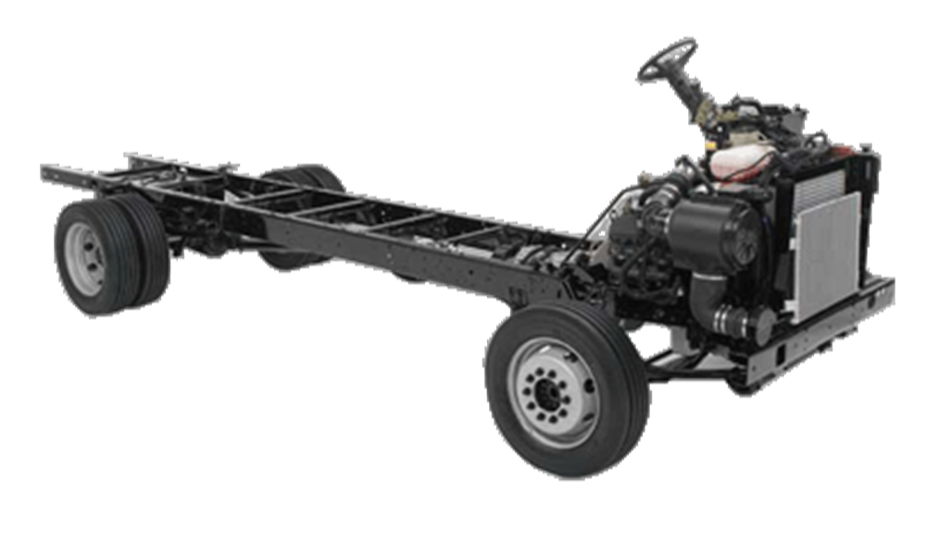
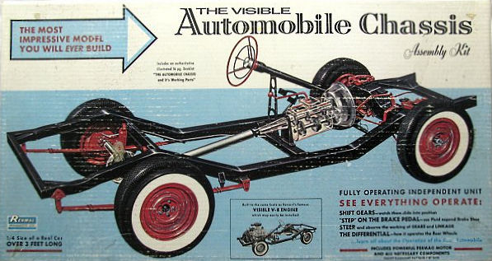

Slide 7
All the components listed above are mounted in either of two ways
Conventional construction
a separate frame is used.

Slide 8
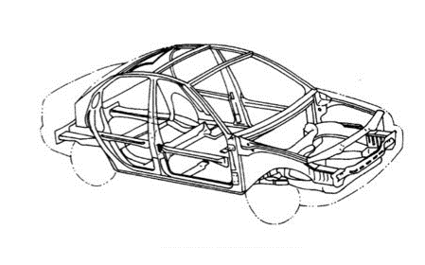
2. Frameless or unitary construction in which no separate frame is employed.

Slide 9
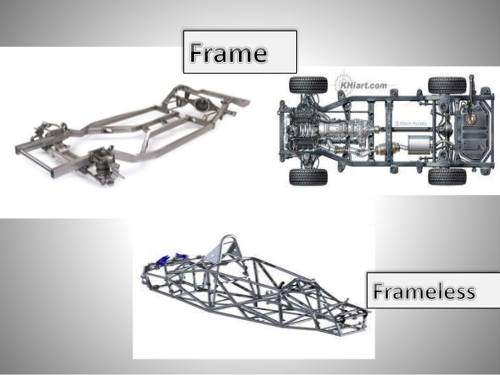

Slide 10
Types of chassis
Conventional control chassis
In which engine is mounted in front of the driver cabin.
Semi forward control chassis
in which engine is so mounted half of it is in driver cabin and other half is in front, outside the driver cabin.
Full forward control chassis
in which the engine is mounted completely inside the driver cabin.

Slide 11
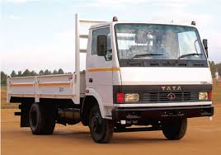
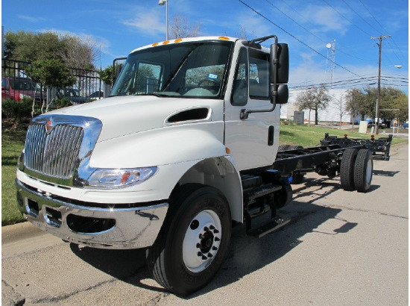
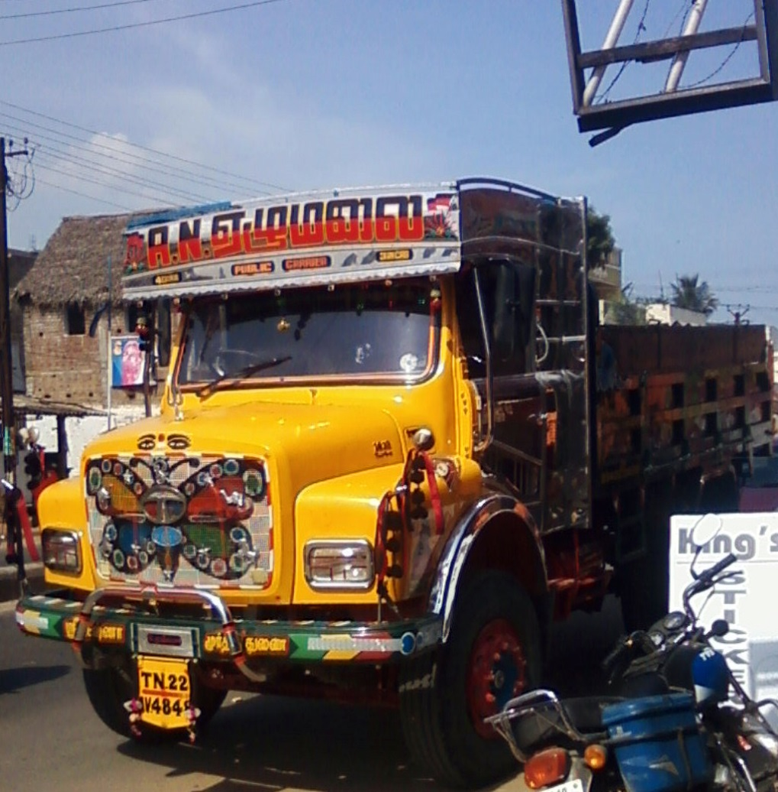

Slide 12
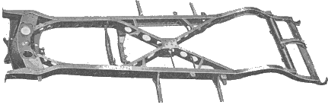
Vehicle Frame
The frame is the main part of the chassis on which remaining parts of chassis are mounted.
The frame should be extremely rigid and strong so that it can withstand shocks, twists, stresses and vibrations to which it is subjected while vehicle is moving on road.
The frame is supported on the wheels and tyre assemblies.
The frame is narrow in the front for providing short turning radius to front wheels. It widens out at the rear side to provide larger space in the body.

Slide 13
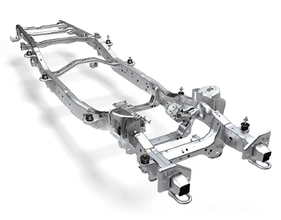
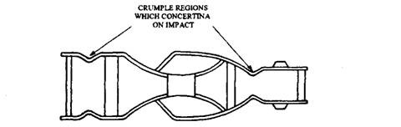
Function of frame
To support the chassis components and the body
To withstand static and dynamic loads without under deflection.

Slide 14
Types of Frame
Conventional Frame
Semi-integral Frame
Integral Frame or Frame-less Construction

Slide 15
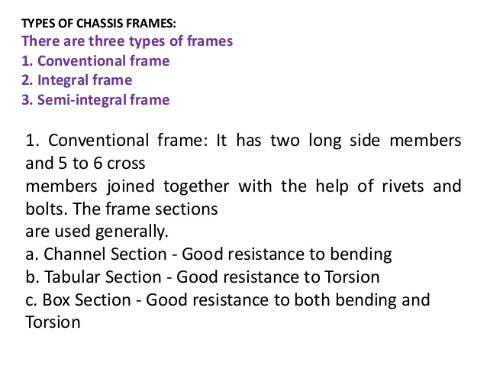

Slide 16
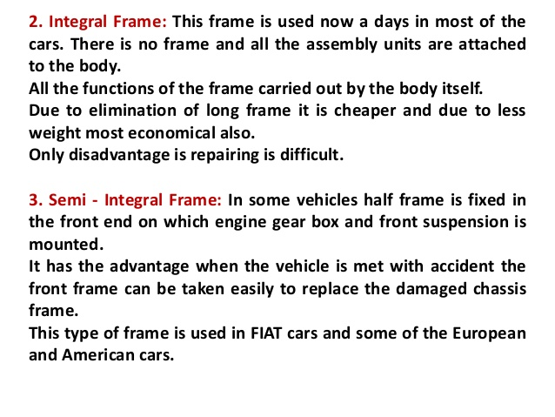

Slide 17
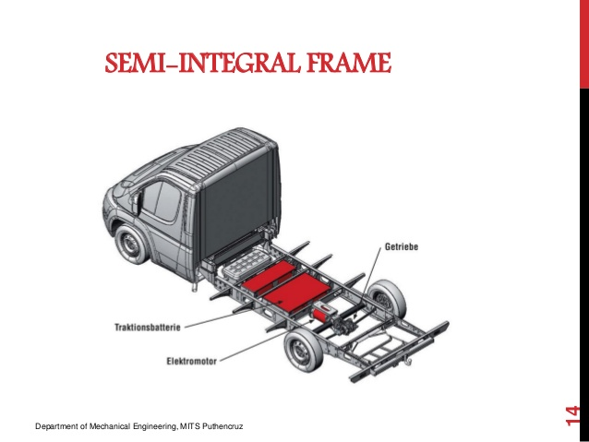

Slide 18
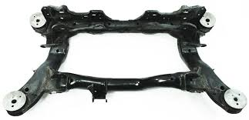
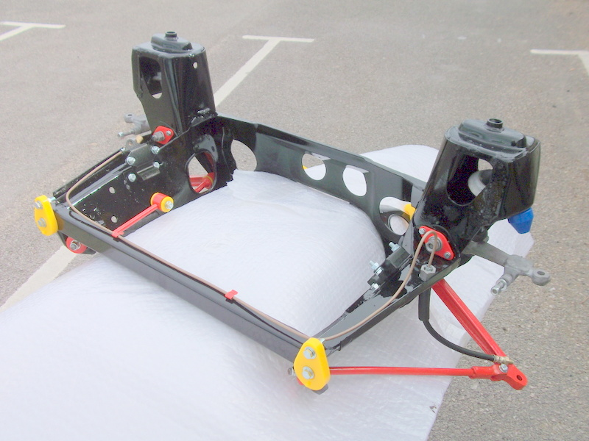
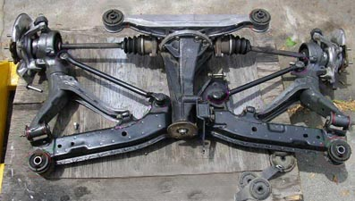
Sub frames
Advantages
The mass of the sub frame alone helps to damp vibrations.
The provisions of sub frame simplifies production on the assembly line and facilitates subsequent repair.

Slide 19
Materials for frame
Percentage | Mild steel plate | Carbon steel plate | 3% Nickel steel Plate
Carbon | 0.15 – 0.20 | 0.22 – 0.27 | 0.25 – 0.35
Manganese | 0.40 – 0.6 | 0.50 – 0.70 | 0.35 - 0.75
Silicon | 0.7 max | 0.07 max | 0.05 max
Phosphorous | 0.5 max | 0.05 max | 0.05 max
Sulphur | 0.05 max | 0.05 max | 0.05 max
Ultimate strength | 450 – 500 | 500 – 670 | 550 – 720
Yield strength (Mpa) | 225 | 250 | 320
Elongation | 20 percent min. on 100 mm | 20 percent min. on 100 mm | 20 percent min. on 100 mm

Slide 20
Types of Drive layout

Slide 21
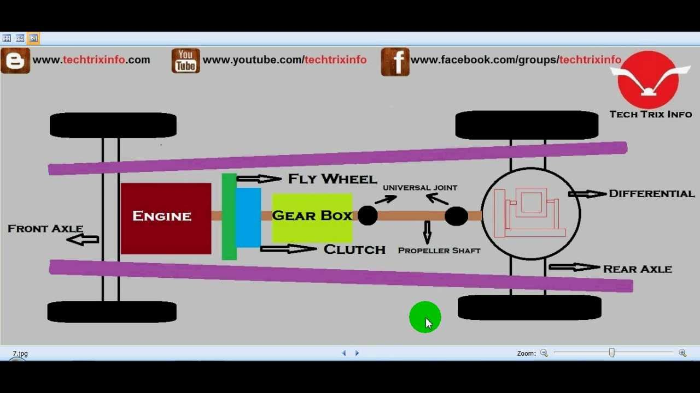
vehicle layouts
vehicle layouts

Slide 22
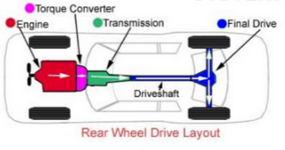

Slide 23
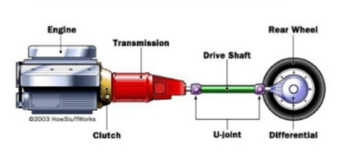
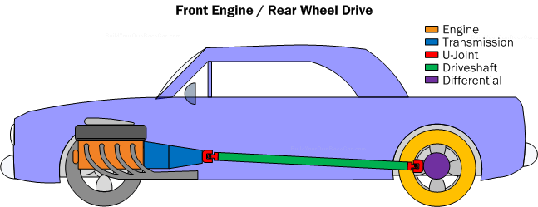
Balance weight distribution.
Easy front wheel streering movement.
Behind rear seat large luggage space is available.
Full benefits for natural engine cooling

Slide 24
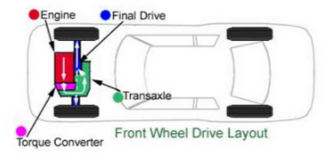
Faster and safer travelling due to good road holding on curve.
Natural engine cooling

Slide 25
Rear engine rear wheel drive
Advantages
Better road adhesion on steep hills and while acceleration
Generally a proportional part of weight of car is transferred to front wheel while braking.
Good visibility
Passengers are kept away from noise heat etc.
Disadvantages
At high speed, increase wt. at rear and make vehicle unstable.
Long linkages are required of clutch gearbox.
Engine cooling problem.

Slide 26
